Slide 1

LESSON 2
Music Theory G1
Quiz: www.chezamusicschool.co.ke/mtg1l1

Slide 2
CONTENTS
Rhythm
01
02
Pitch
Rhythm 2
03
04
Pitch 2

Slide 3
CONTENTS
Rhythm 3
05
06
Scales
Keys & Key Signatures
07
08
Intervals

Slide 4
CONTENTS
Tonic Triads
09
10
Terms & Signs

Slide 5
03
Rhythm Part 2
Grade 1
THE SEMIQUAVER
GROUPING NOTES
RESTS

Slide 6
Terms & Signs for the day:
                Mezzo-piano (mp) - moderately quiet
Mezzo-forte (mf) - moderately loud
Fortissimo (ff) - Very loud
Pianissimo (pp) - Very quiet
Decrescendo (decresc) - Gradually getting quieter
Allegro - quick
Adagio - slow

Slide 7
𝅘𝅥𝅯+𝅘𝅥𝅯=𝆕
The Semiquaver
𝅘𝅥𝅯
The semiquaver is half the value of a quaver. This is the shortest time value in grade 1.
Two semiquavers add up to a quaver. Since a quaver is an eighth note, a semiquaver’s value is a sixteenth note. Four of them make a crotchet beat.
How many semiquavers make a minim?
- A minim lasts as long as two crotchets
- Each of the two crotchets last as long as two quavers
- That makes four quavers (2x2)
- Each of the quavers last as long as two semiquavers -> 4x2 = 8

Slide 8
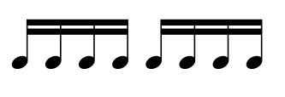
The Semiquaver
𝅘𝅥𝅯+𝅘𝅥𝅯+𝅘𝅥𝅯+𝅘𝅥𝅯= 𝅘𝅥
Four semiquavers add up to a crotchet. Since we know the crotchet as our beat, four semiquavers are often beamed together to ‘show the beat’.
Beaming semiquavers into fours clearly shows the crotchet beat.

Slide 9
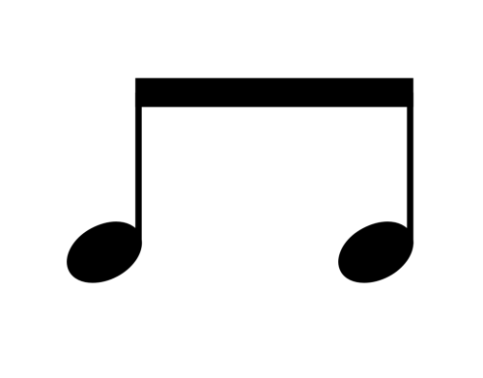
𝅘𝅥
𝅘𝅥
𝅘𝅥𝅮
𝅘𝅥𝅮
𝅘𝅥𝅯𝅘𝅥𝅯 𝅘𝅥𝅯𝅘𝅥𝅯

Slide 10




Grouping Notes
When quavers and semiquavers are part of the same beat, they are usually grouped together through beaming.
When four semiquavers are together part of a crotchet beat, they are grouped together with two beams
Four semiquavers
Mixed
When a quaver and two semiquavers are together part of the same crotchet beat, they are beamed as shown. The quaver is thus distinct from the wto semiquavers
When two semiquavers and a quaver are together part of a crotchet beat, they are beamed as shown here. The two quavers are clearly different from the one quaver.
When the quaver is in the middle of two semiquavers and they together are part of the same beat, they are beamed as shown. The quaver in the middle cannot be confused with the semiquavers besides it.
Mixed
Mixed

Slide 11
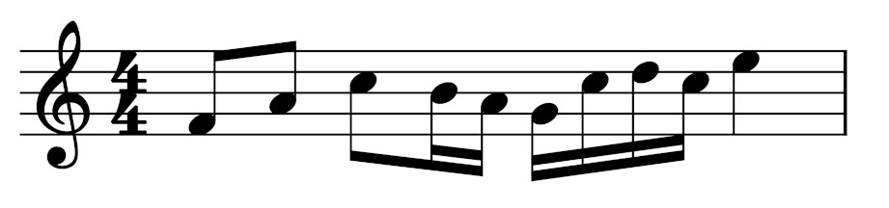
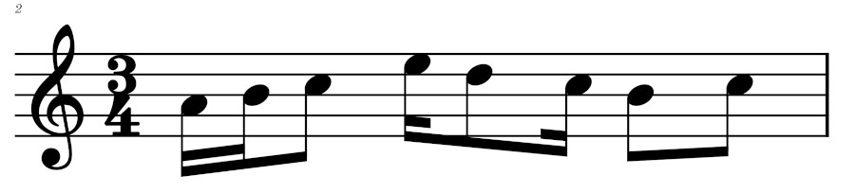
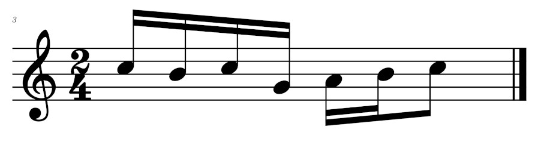
Identify the beats in the following bars

Slide 12
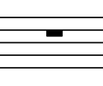
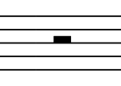
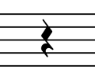
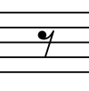

Rests
The silent moments in music are shown using rests. Rests, therefore need to be counted too, just like notes.
A semibreve rest hangs on the fourth line of the staff. It is worth 4 beats of silence or notates a completely silent bar
A minim rest sits on the third line of the stave. It is worth 2 beats of silence.
A crotchet rest is written as shown above. It is worth 1 beat of silence.
A quaver rest is written as shown above. It is worth half beat of silence.
A semiquaver rest is written as shown above. It is worth a quarter beat of silence.

Slide 13
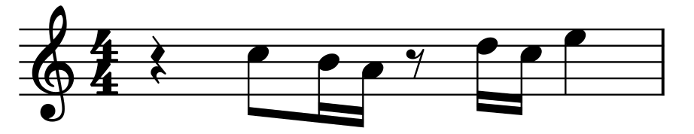
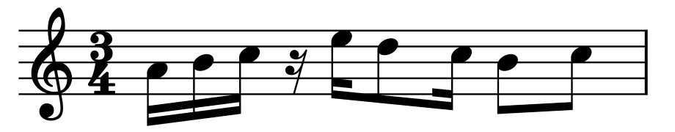
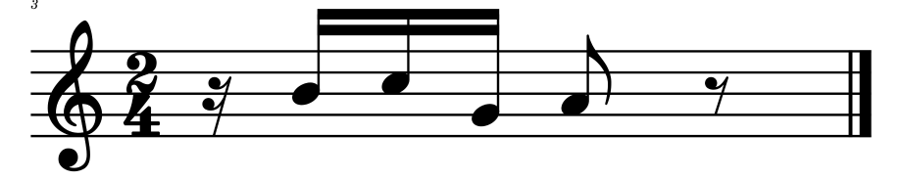
Examples with rests

Slide 14
04
Pitch Part 2
Grade 1
ACCIDENTALS
MORE ON ACCIDENTALS
SEMITONES AND TONES

Slide 15
Accidentals
Sharp
When a sharp (♯) is written in front of a note, it makes the note sound higher.
Sharp
When a flat(♭) is written in front of a note, it makes the note sound lower.
Sharp
Flat
♯
♭
Natural
Normal
Natural
A natural (♮) changes a note with a sharp or a flat back to its normal pitch
♮
Normal
A note with a normal pitch is not written with any accidental, unless a natural is necessary.

Slide 16
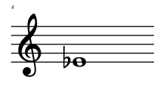
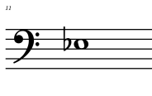
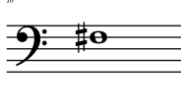
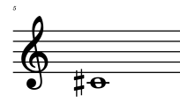
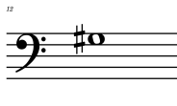
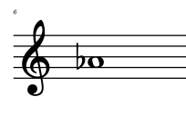
Notes with accidentals
F♯
E♭
E♭
C♯
G♯
A♭

Slide 17
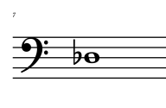
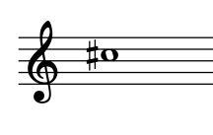
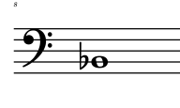
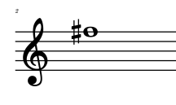
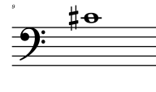
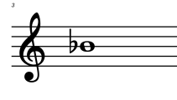
Notes with accidentals
D♭
C♯
B♭
F♯
C♯
B♭

Slide 18
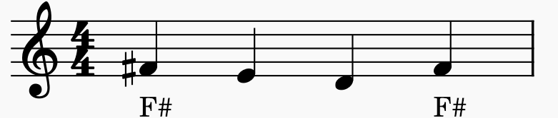
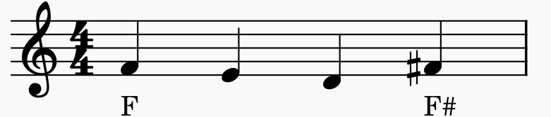
Accidentals
An accidental changes all the notes of the same pitch in a bar. An accidental can only change the pitch of the notes that come after it, not before it. Both Fs above are played as F#
Unlike the first example, only the last F is affected by the sharp.

Slide 19
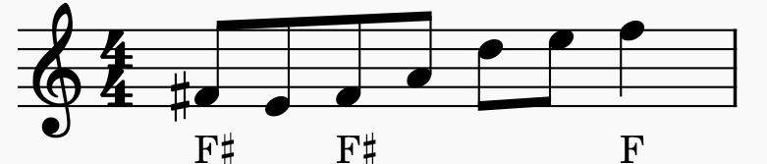
Accidentals
An accidental only applies to notes on the same line or in the same space. The first and the second Fs in the above example will be played as F#. However, the last F will not be F# because it is a different pitch. If we want it to be F sharp too, we can give it an accidental of its own.

Slide 20
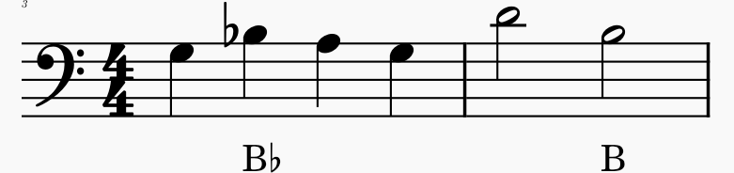
Accidentals
An accidental only applies in the same bar and is cancelled by a bar line. In the above example, the second B will not be affected by the accidental in the first bar because the bar line cancelled the flat. If we want the second B to be flattened, we should give it its own accidental.

Slide 21
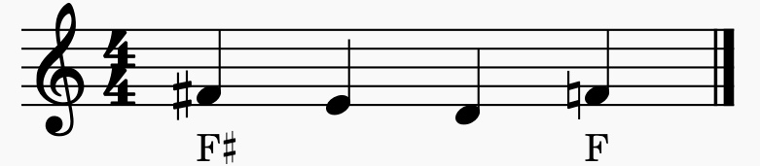
Accidentals
To cancel an accidental within a bar, we use the natural accidental in front of a note. In the above example, the Sharp in the first F is cancelled using the natural in front of the last F. So, the first F is played as F# but the last one is Natural F. Without the natural sign, the last F would still be played as F Sharp.

Slide 22
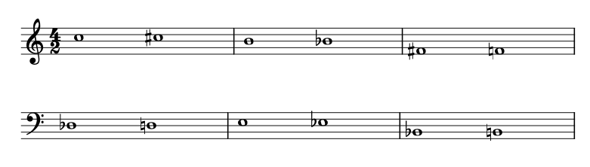
Find the higher note in each bar
Remember a sharp raises a note by a semitone, a flat lowers a note by a semitone and a natural restores a not to its normal pitch.

Slide 23
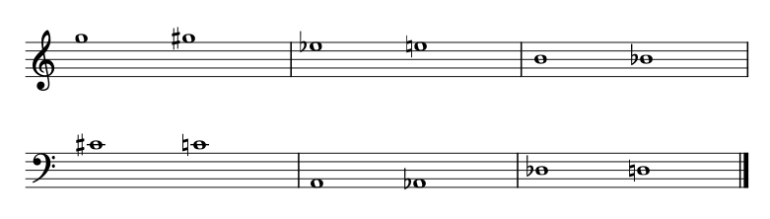
Find the lower note in each bar
Remember a sharp raises a note by a semitone, a flat lowers a note by a semitone and a natural restores a not to its normal pitch.

Slide 24
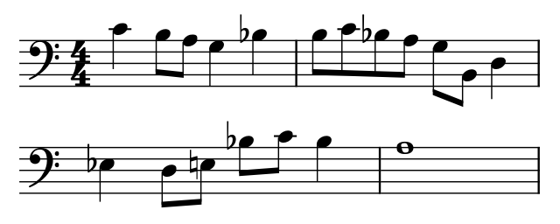
What are the notes shown by arrows above?
Remember what you have learned about accidentals and answer before going to the next slide.

Slide 25
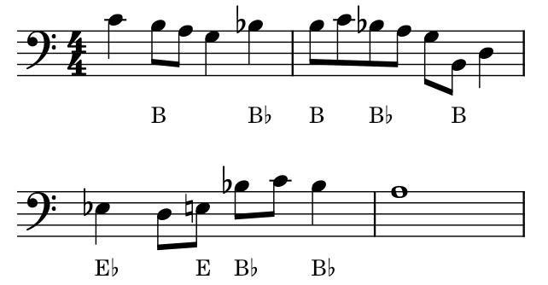

Slide 26
Tones and Semitones
Tones and Semitones are words used to describe the distance between two notes.
A semitone is the shortest distance we can measure between two notes.
A tone is two semitones.
                On a piano, there is a semitone between every note, whether white or black.
Note: Each black key on the piano has two names. A sharp of the white key below it and a flat of the white key above it.

Slide 27
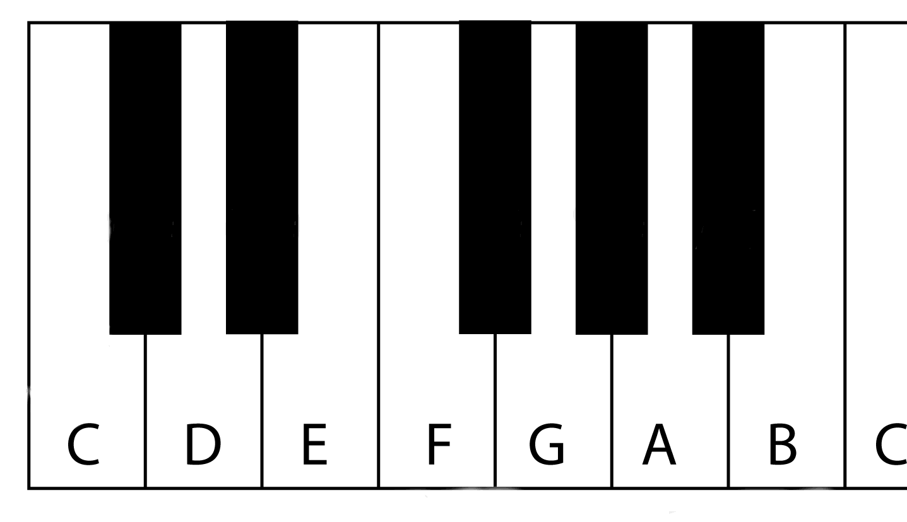
Notes on the piano. Note the semitone intervals between each two notes.
C♯
D♭
D♯
E♭
F♯
G♭
G♯
A♭
A♯
B♭

Slide 28
Tones and Semitones
The distance from E to F and B to C is a semitone because there is no black key between them.
The distance from C to D is a tone because we have a C# between them.
Whenever you skip a note, that is a tone. If you don’t skip a note, that is a semitone.

Slide 29
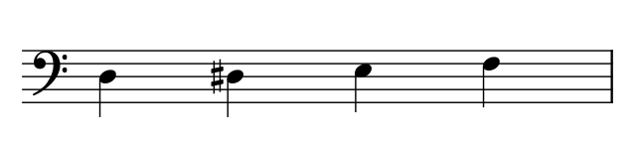
Tones and Semitones
Semitone
Semitone
Semitone
Tone
Tone

Slide 30
Draw and label the notes on the piano.
This might be the first thing you’ll need to do before doing any test, so learn how to draw a piano now. Not tomorrow, now.

Slide 31
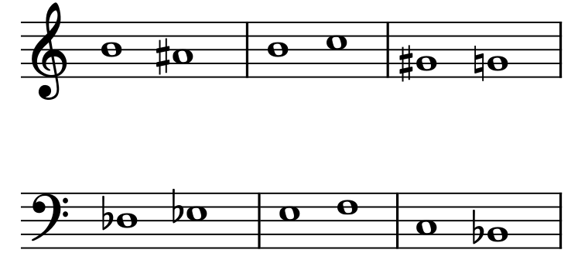
Identify tones and semitones in each bar below.
Semitone
Semitone
Semitone
Tone
Semitone
Tone

Slide 32
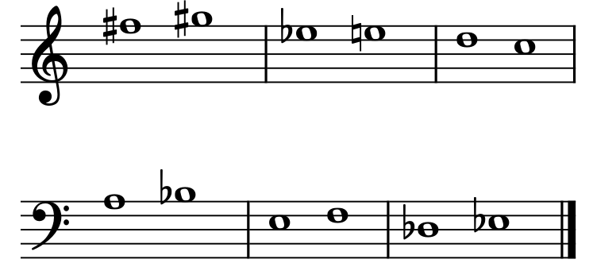
Identify tones and semitones in each bar below.
Tone
Semitone
Tone
Semitone
Semitone
Tone

Slide 33
Thank you, Friends
Quiz: www.chezamusicschool.co.ke/mtg1l1

