Slide 1

LESSON 2
Music Theory G2
Quiz: www.chezamusicschool.co.ke/mtg2l2

Slide 2
CONTENTS
Pitch
01
02
Rhythm 1
Rhythm 2
03
04
Rhythm 3

Slide 3
CONTENTS
Keys & Scales 1
05
06
Keys & Scales 2
Intervals
07
08
Tonic Triads

Slide 4
CONTENTS
Terms and Signs
09

Slide 5
Terms & Signs for the day:
                espressivo - expressive
                grazioso - graceful
                alla marcia - in the style of a march
molto - very, much
non troppo - not to much
poco, poco a poco - a little; little by little
col, con - with
e, ed - and
ma - but
meno - less
piu - more
senza - without

Slide 6
03
Rhythm Part 2
Grade 2
TRIPLETS
TRIPLETS OVER MULTIPLE BEATS
DOTTED RESTS

Slide 7
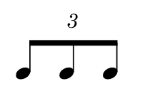
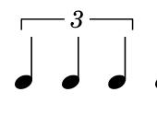
Triplets
A triplet is a group of three notes that are played in the same amount of time as two non-triplet notes of the same time value
Triplets are shown by a 3, which is added either to the middle of the beam or to a bracket when the triplet notes aren’t beamed together.

Slide 8


The notes below are equal to one crotchet.
=
=

Slide 9


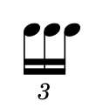
The notes below are equal to one quaver.
=
=

Slide 10
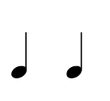
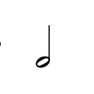
The notes below are equal to one minim.
=
=

Slide 11
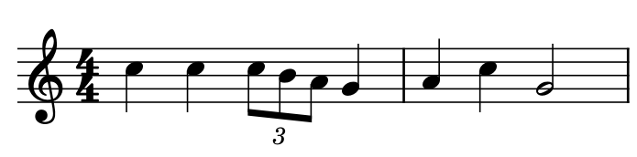
Triplets in a measure. The triplets here make one beat

Slide 12
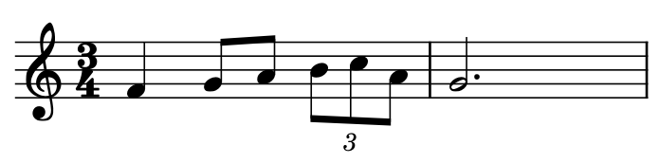
Triplets in a measure. The triplets here make one beat

Slide 13
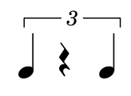
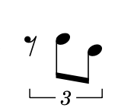
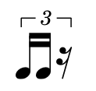
Here are some triplets that include rests
=
=
=

Slide 14
Is the following a complete bar?
3
4

Slide 15
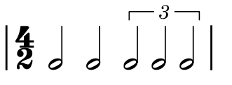
Triplets over multiple beats
Sometimes triplets add up to more than one beat. Below is an example:
Two beats

Slide 16
Is the following a complete bar?
4
4
4
4

Slide 17
Is the following a complete bar?
4
4
4
4

Slide 18
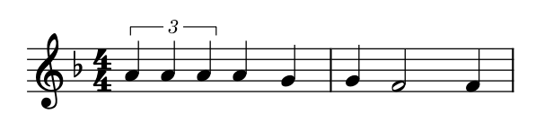
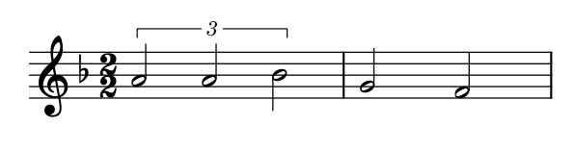
Analyse the following and note how triplets cover more than a beat.
Two beats
Two beats

Slide 19
Remember:
A group of three triplet notes is always equal to two non-triplet notes of the same time value.

Slide 20




Dotted rests
Dotted rests work in exactly the same way as dotted notes: a dot after a rest adds on half the value of the rest again.
=
=

Slide 21
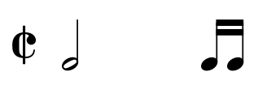
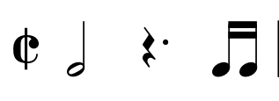
Which one rest will be added below to complete the bar?

Slide 22
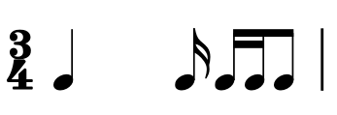
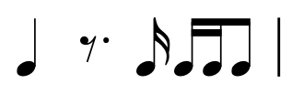
Which one rest will be added below to complete the bar?

Slide 23
04
Rhythm Part 3
Grade 2
GROUPING NOTES
GROUPING NOTES ACROSS MULTIPLE BEATS
GROUPING RESTS

Slide 24
Grouping notes
- We group notes together in order to make music easier to read
- In grade 1 we learnt that quaver and semiquavers are joined together with beams. Using beams makes it easier to see how rhythms fit into the beat. When many different time values are being used, grouping is very important.

Slide 25
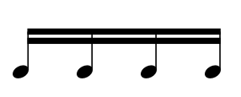
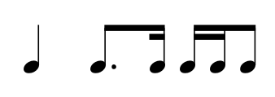
- Quavers and semiquavers can be beamed into beats.
- In time signatures with a crotchet beat, they can be beamed into crotchets;
4
4
0

Slide 26
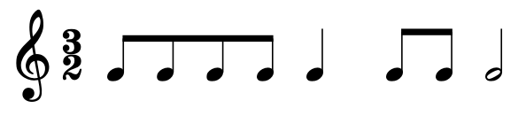
- Quavers can be beamed into beats.
- In time signatures with a minim beat, they can be beamed into minims

Slide 27
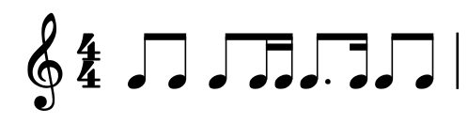
The following measures are grouped correctly. See how each beat is ‘readable’.
Minim is the beat
Crotchet is the beat

Slide 28
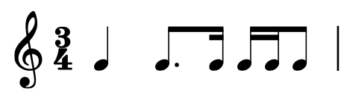
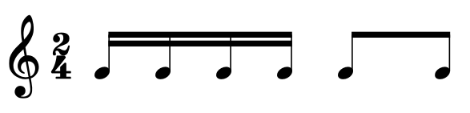
The following measures are grouped correctly. See how each beat is ‘readable’.
Crotchet is the beat
Crotchet is the beat

Slide 29
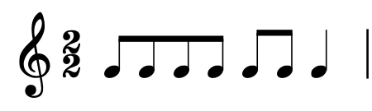
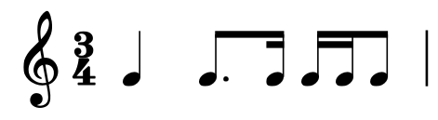
The following measures are grouped correctly. See how each beat is ‘readable’.
Minim is the beat
Crotchet is the beat

Slide 30
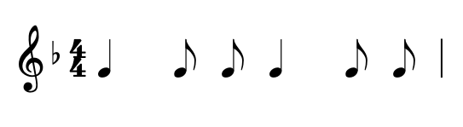
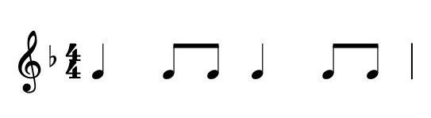
How should the following measure be grouped?

Slide 31
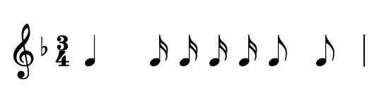
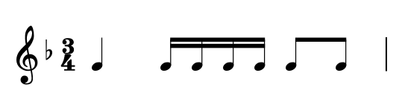
How should the following measure be grouped?

Slide 32
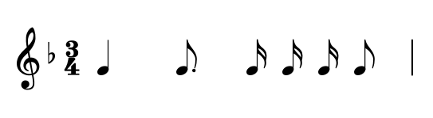
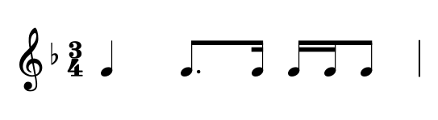
How should the following measure be grouped?

Slide 33
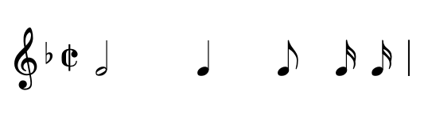
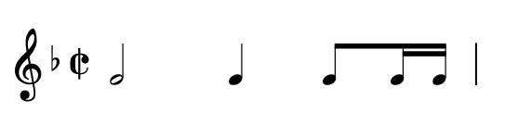
How should the following measure be grouped?

Slide 34
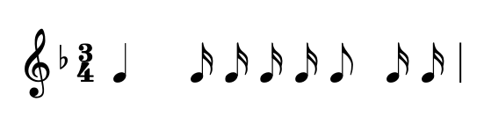
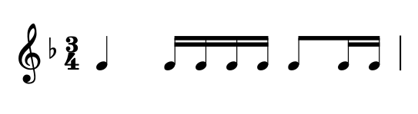
How should the following measure be grouped?

Slide 35
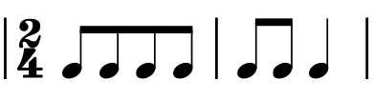
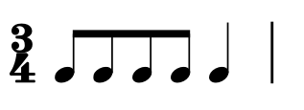
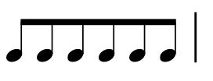
Grouping notes across multiple beats
In and , notes can be beamed over multiple beats within a bar
-> Beam quavers that add up to two crotchet beats.
2
4
3
4
Beam six quavers that make a complete bar
3
4

Slide 36
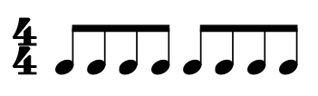
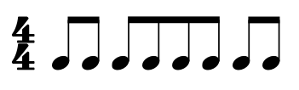
Grouping notes across multiple beats
In , quavers can be beamed in groups of up to four, but not across the middle of the bar.
4
4

Slide 37
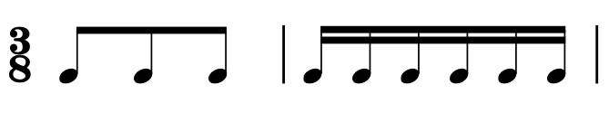
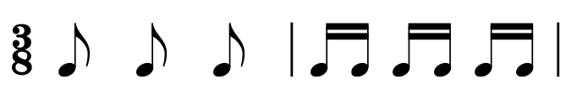
Grouping notes across multiple beats
In , quavers and semiquavers are beamed into bars
3
8

Slide 38
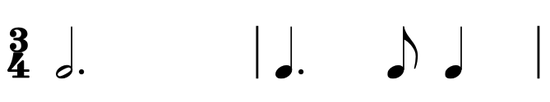
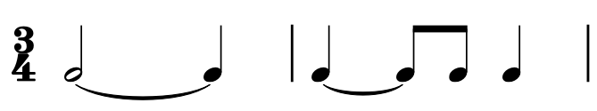
Grouping notes across multiple beats
For notes that last longer than a beat, it is not necessary to show each new beat with a new tied note. Avoid using ties within a bar when a single note could be used instead.

Slide 39



Grouping rests
Use a single rest for a complete bar of silence in any time signature. This will always be a semibreve rest.

Slide 40
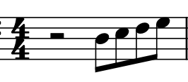
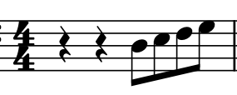
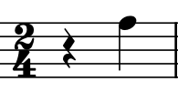
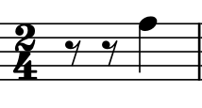
Grouping rests
Use a single rest when the first or second half or a or is silent.
4
4
2
4

Slide 41
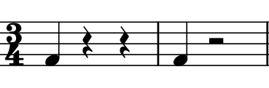
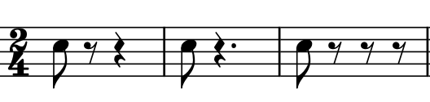

Grouping rests
In other circumstances, use one rest for each beat of silence

Slide 42
Thank you, Friends
Quiz: www.chezamusicschool.co.ke/mtg2l2

