Slide 1

LESSON 1
Music Theory G3
Quiz: www.chezamusicschool.co.ke/mtg3l1

Slide 2
CONTENTS
Rhythm 1
01
02
Rhythm 2
Pitch
03
04
Keys & Scales 1

Slide 3
CONTENTS
Keys & Scales 2
05
06
Intervals
Tonic Triads
07
08
Terms and Signs

Slide 4
Terms & Signs for the day:
leggiero - light
maestoso - majestic
marcato (mark.)- emphatic, accented
pesante - heavy
risoluto - bold, strong
scherzando - playful, joking
semplice - simple, plain
sostenuto (sost.)- sustained
tranquillo - calm
triste, tristamente - sad, sorrowful
sforzando, sforzato, sf, sfz - forced, accented
andantino - slightly faster/slower than andante
prestissimo - very fast
agitato - agitated
animato - animated, lively
con forza - with force
energico - energetic
giocoso - playful, merry

Slide 5
01
Rhythm 1
Grade 3
THE DEMISEMIQUAVER
TRIPLET DEMISEMIQUAVERS
STARTING ON AN UPBEAT
DUPLE, TRIPLE AND QUADRUPLE TIME
GROUPING NOTES AND RESTS

Slide 6
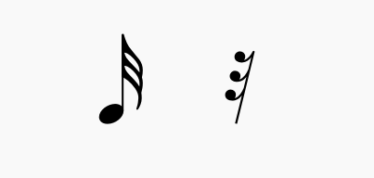
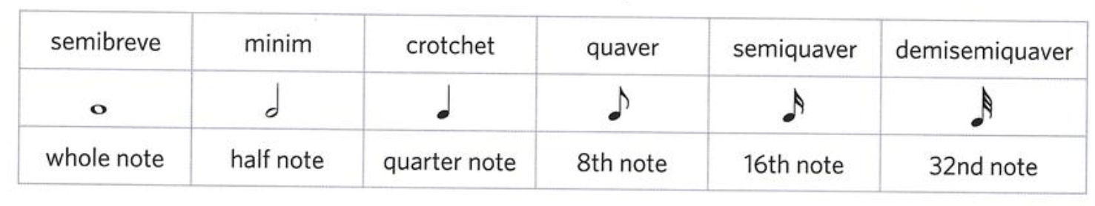
The demisemiquaver
The demisemiquaver is one of the shortest time values in music notation.
It has 3 flags/tails or beams when it is part of a group

Slide 7
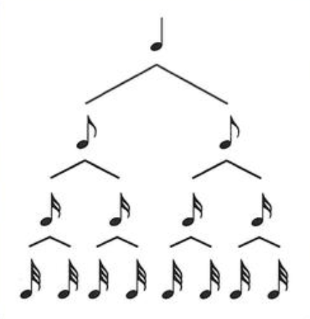
The demisemiquaver
There are 8 demisemiquavers in a crotchet.
Each demisemiquaver is also half of a semiquaver.

Slide 8
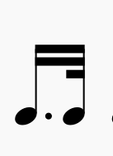
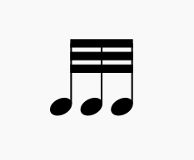
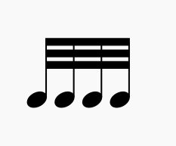
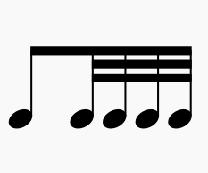
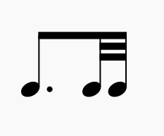
The demisemiquaver
Like quavers and semiquavers, demisemiquavers can be grouped together using beams. They can be grouped with all notes with flags. Look at the examples below

Slide 9
Complete the sentences below:
A semiquaver is equal to ____________ semidemiquavers
A minim is equal to ____________ semidemiquavers
A dotted crotchet is equal to ____________ semidemiquavers
Four semiquavers are equal to ____________ semidemiquavers
A crotchet is equal to ____________ semidemiquavers

Slide 10
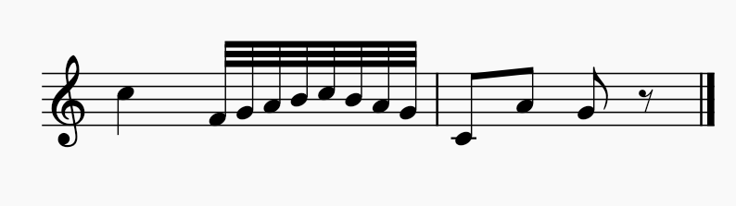
What is the time signature of the melody below?
The time signature is 2/4. Eight demisemiquavers are equal to one crotchet

Slide 11
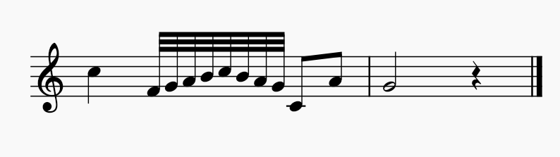
What is the time signature of the melody below?
The time signature is 3/4. Eight demisemiquavers are equal to one crotchet

Slide 12
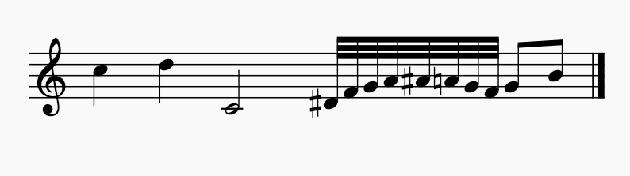
What is the time signature of the melody below?
The time signature is 3/2. Eight demisemiquavers are equal to one crotchet

Slide 13
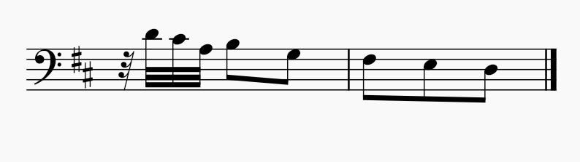
What is the time signature of the melody below?
The time signature is 3/8. Four demisemiquavers are equal to one quaver

Slide 14
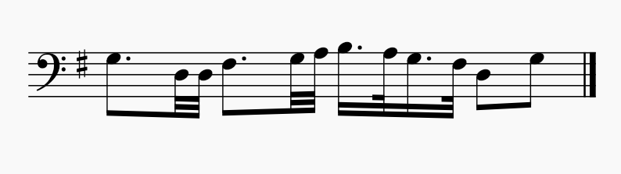
What is the time signature of the melody below?
The time signature is 4/4. Two demisemiquavers are equal to one semiquaver

Slide 15
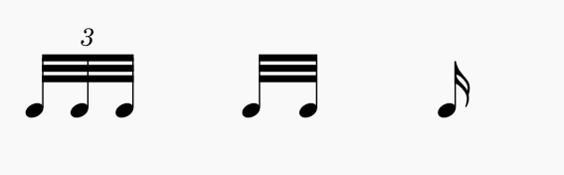
Triplet Demisemiquavers
Reminder: A triplet is a group of three notes that are played in time of two of
the same time value.
A triplet of demisequavers are therefore equal to one semiquaver (or two
demisemiquavers).

Slide 16
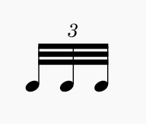
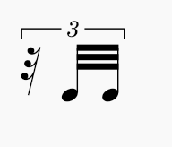
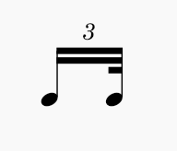
A triplet may include notes and rests of different time values.
The 3 written above with or without a bracket shows a triplet

Slide 17
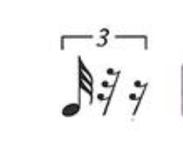
Is the triplet below correctly written to be equal to a semiquaver?
No, a demisemiquaver triplet should have 3 semisemiquavers.

Slide 18
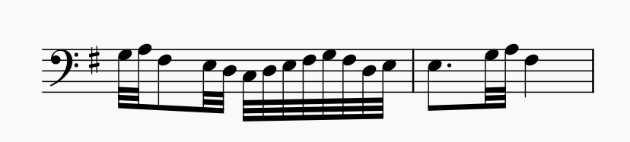
What is the time signature for the following melody?
The time signature is 2/4. Observe the grouping.

Slide 19
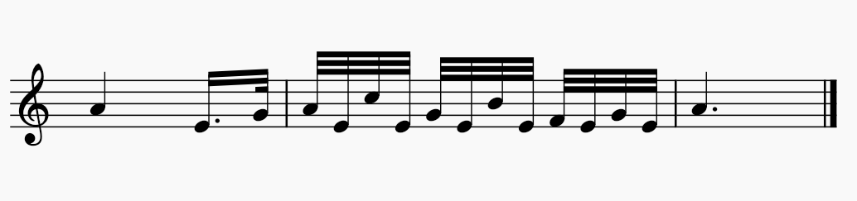
What is the time signature for the following melody?
The time signature is 3/8. Observe the grouping.

Slide 20
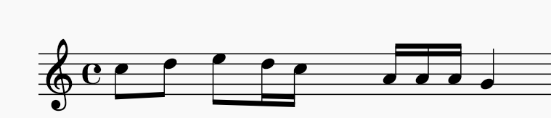
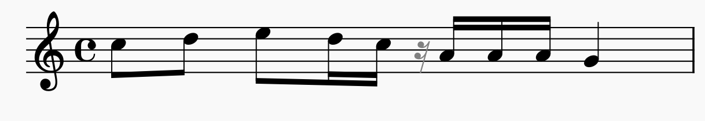
Which rest(s) can be added in the place shown by a square below?
A semiquaver rest is added to complete the third crotchet beat.

Slide 21
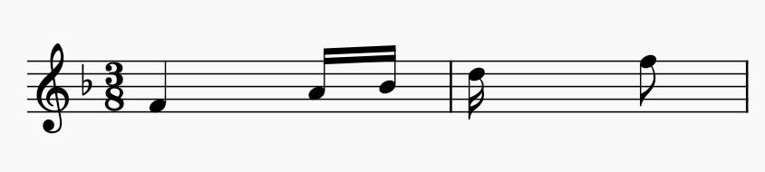
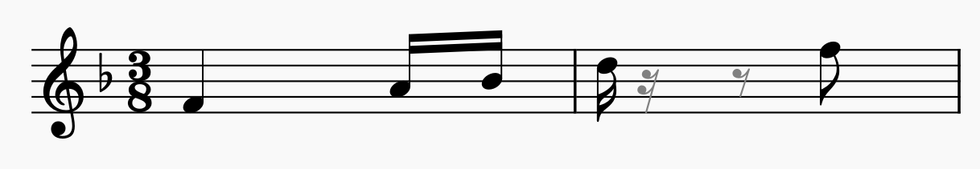
Which rest(s) can be added in the place shown by a square below?
A semiquaver rest is added to complete the first quaver beat, then a
quaver rest is added to cover the second quaver beat. Each new silent
beat needs a new rest.

Slide 22
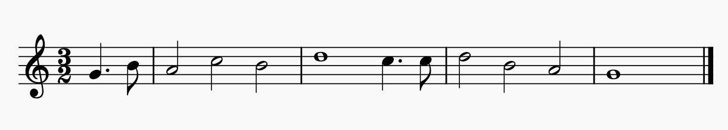
Starting on an upbeat
While some music will start on the first beat of the bar, some don’t.
An upbeat, mostly the last beat of the bar, can be the first note of a music.
When this is the case, the last bar will be short of the value in the first bar, so that
the first and last bars make a complete bar.

Slide 23
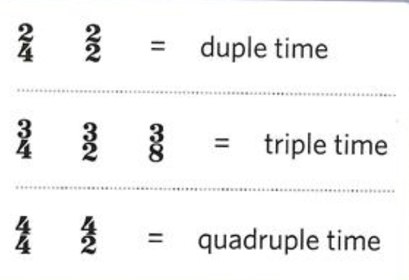
Duple, triple, and quadruple time
Time signatures may be described as duple, triple, or quadruple time,
depending on the number of beats in each bar.
A duple time signature has two beats in a bar.
A triple time signature has three beats in a bar.
A quadruple time signature has four beats in a bar.
The type of beat doesn’t matter, only the number of beats in a bar.

Slide 24
Grouping of notes and rests
Beams: Quavers, semiquavers, and demisemiquavers can be grouped together
across one or more beats. Avoid beaming them together across the middle
of a 4/4 bar.
Rests: Each whole bar, half bar, or whole beat of silence should have
its own rest. For silences in the middle of a beat, use a new rest for each half
beat. Whole bars of silence should use a semibreve rest.
Ties: Avoid ties where single notes can be written instead.

Slide 25
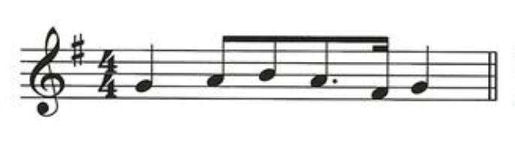
Is the following bar grouped correctly?
No, avoid grouping notes across the middle of a 4/4 bar.

Slide 26
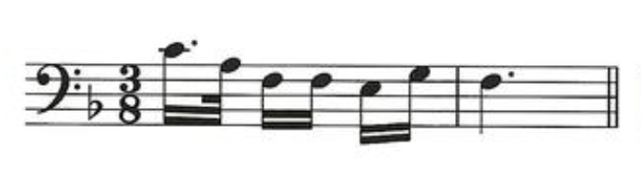
Is the following bar grouped correctly?
No, group everything with flags in 3/8 time.

Slide 27
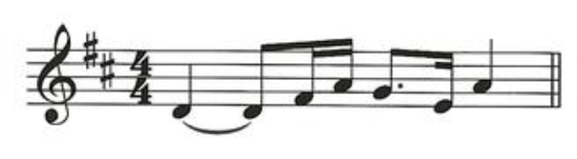
Is the following bar grouped correctly?
No, avoid ties where single notes could be written instead..

Slide 28
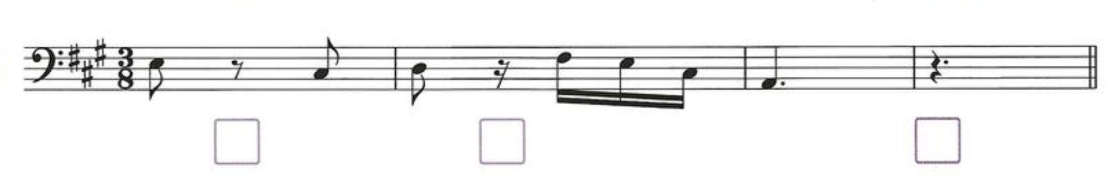
Which of the following bars isn’t grouped correctly?
The last bar. A completely silent bar should use a semibreve rest.

Slide 29
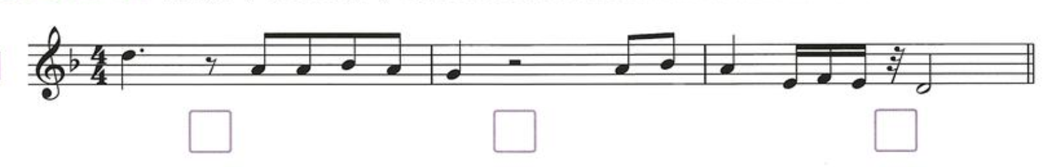
Which of the following bars isn’t grouped correctly?
The second bar. Don’t group rests in the middle of 4/4 bar.
The last bar: The rest should be a semiquaver rest instead.

Slide 30
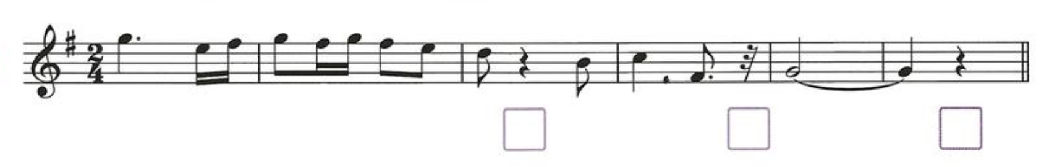
Which of the following bars isn’t grouped correctly?
The third bar. For silences in the middle of a beat, use a new rest for each half beat.
The fourth bar: The rest should be a semiquaver rest instead.

Slide 31
Rewriting melodies in half or double values
Rhythms can be written in different time signatures by doubling or
halfing all the time values.
2/4 will become 2/2 when all the notes are doubled, and vice-versa
3/8 will become 3/4 when all the notes are doubled, and vice-versa
4/2 will become 4/4 when all the notes are halved, and vice-versa
Take note that the number of beats do not change.

Slide 32
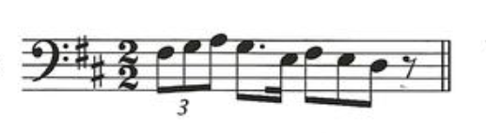
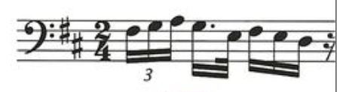
Example:
When all the values in the above bar are halved, the following will be
the new time signature and notes:

Slide 33
Thank you, Friends
Quiz: www.chezamusicschool.co.ke/mtg3l1

