Slide 1

LESSON 1
Music Theory G1
Quiz: www.chezamusicschool.co.ke/mtg1l1

Slide 2
CONTENTS
Rhythm
01
02
Pitch
Rhythm 2
03
04
Pitch 2

Slide 3
CONTENTS
Rhythm 3
05
06
Scales
Keys & Key Signatures
07
08
Intervals

Slide 4
CONTENTS
Tonic Triads
09
10
Terms & Signs

Slide 5
01
Rhythm
Grade 1
TIME VALUES
BARS AND METRE
TIME SIGNATURE
CLAPPING RHYTHM

Slide 6
Terms & Signs for the day:
Piano (p) - quiet
Forte (f) - loud
Crescendo (cresc) - Gradually getting louder
Diminuendo (dim) - Gradually getting quieter

Slide 7
𝅝
𝅗𝅥
Note Values
Semibreve
Minim
Also called a whole note. It has 4 counts
𝅘𝅥
Also called a half note. It has 2 counts
𝅘𝅥𝅮
𝅘𝅥 𝅘𝅥
Crotchet
Quaver
Also called a quarter note. It has 1 count
Also called eighth note. It has 1/2 count

Slide 8
𝅝
𝅗𝅥
𝅗𝅥
𝅘𝅥
𝅘𝅥
𝅘𝅥
𝅘𝅥
𝅘𝅥𝅮
𝅘𝅥𝅮
𝅘𝅥𝅮
𝅘𝅥𝅮
𝅘𝅥𝅮
𝅘𝅥𝅮
𝅘𝅥𝅮
𝅘𝅥𝅮

Slide 9
𝅝
𝅗𝅥
𝅗𝅥
𝅘𝅥
𝅘𝅥
𝅘𝅥
𝅘𝅥
𝅘𝅥 𝅘𝅥
𝅘𝅥 𝅘𝅥
𝅘𝅥 𝅘𝅥
𝅘𝅥 𝅘𝅥

Slide 10
Bars and Rhythm
Rhythm
Bar-line
Pulse
Rhythm is the arrangement of notes of different time values over a pulse
The pulse is organized into bars containing certain number of counts/beats.
Bar
𝅗𝅥 𝅘𝅥 𝅘𝅥 𝄀 𝅘𝅥 𝅘𝅥 𝅘𝅥 𝅘𝅥 𝄀 𝅗𝅥 𝅗𝅥 𝄂
Metre
1 2 3 4 1 2 3 4 1 2 3 4
Bar-lines
Metre is the organization of pulse into regular patterns of a certain number of counts in each bar.
Double bar-line
Bar-lines divide bars. They show where bars begin and where they end.

Slide 11
Time Signature
A time signature tells us how many beats there are in each bar.
A time signature is always written at the beginning of a piece of music, as shown below.
4
4
In grade 1, we will learn 3 time signatures:
- Four beats in a bar
- Three beats in a bar
- Two beats in a bar
𝅗𝅥 𝅘𝅥 𝅘𝅥 𝄀 𝅘𝅥 𝅘𝅥 𝅘𝅥 𝅘𝅥 𝄀 𝅗𝅥 𝅗𝅥 𝄂

Slide 12
Time Signature
TOP
Top Number
2
4
3
4
4
4
3
4
The top number of the time signature tells us the number of beats in every bar. The time signature below means the score that follows it will have four (4) beats in each bar.
Bottom Number
4
4
The bottom number of the time signature tells us the time value of each beat. At grade 1, the time value for a beat will always be a crotchet or quarter note.
BOTTOM
TOP

Slide 13
  𝄴
=
  4
  4
  The sign 𝄴 means 4/4 time signature. It stands for ‘common time’ which in music means 4 crotchet beats in a bar.

Slide 14
01
Clapping Rhythms
Activity
RHYTHM IN PRACTICE
Clap the rhythms in the following slide as you count the pulse.

Slide 15
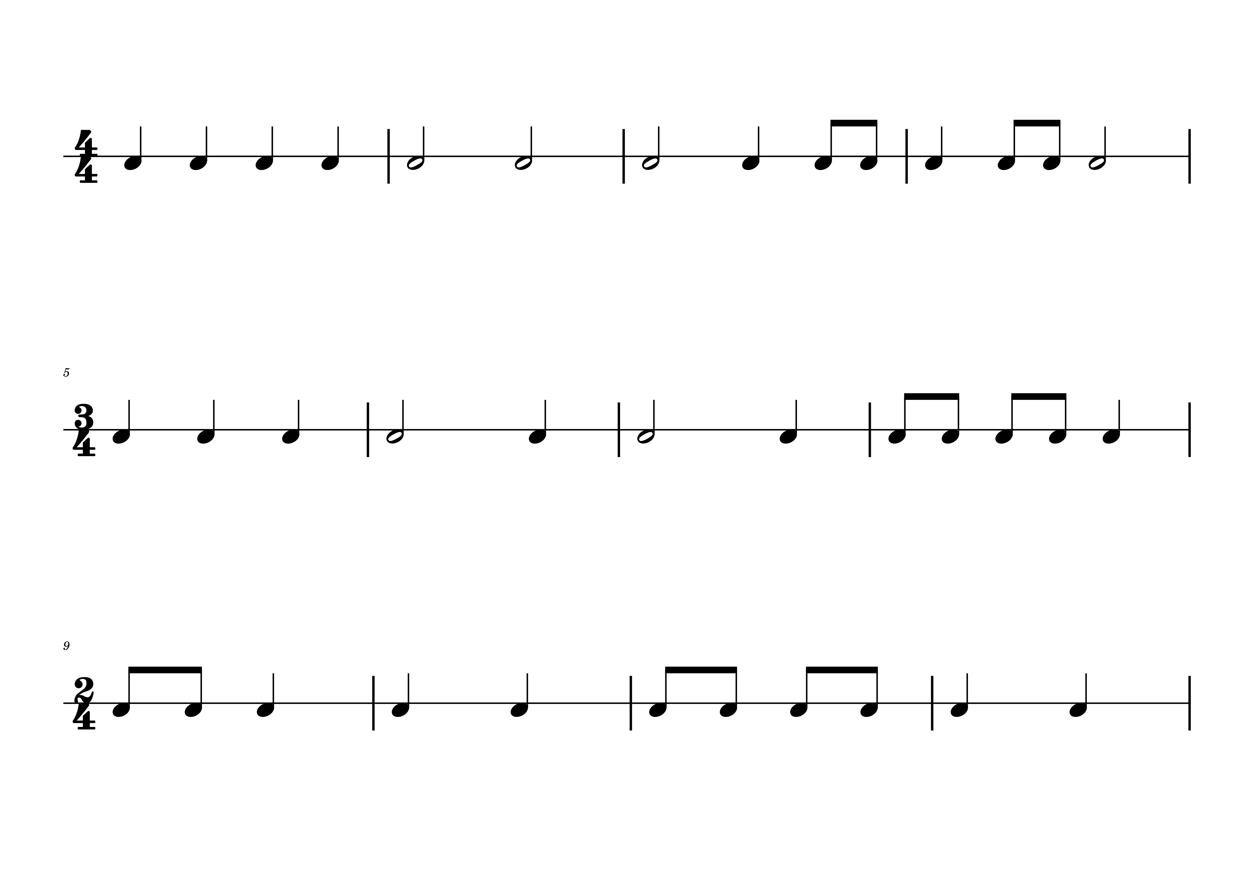
Rhythms to clap

Slide 16

Rhythms to clap

Slide 17
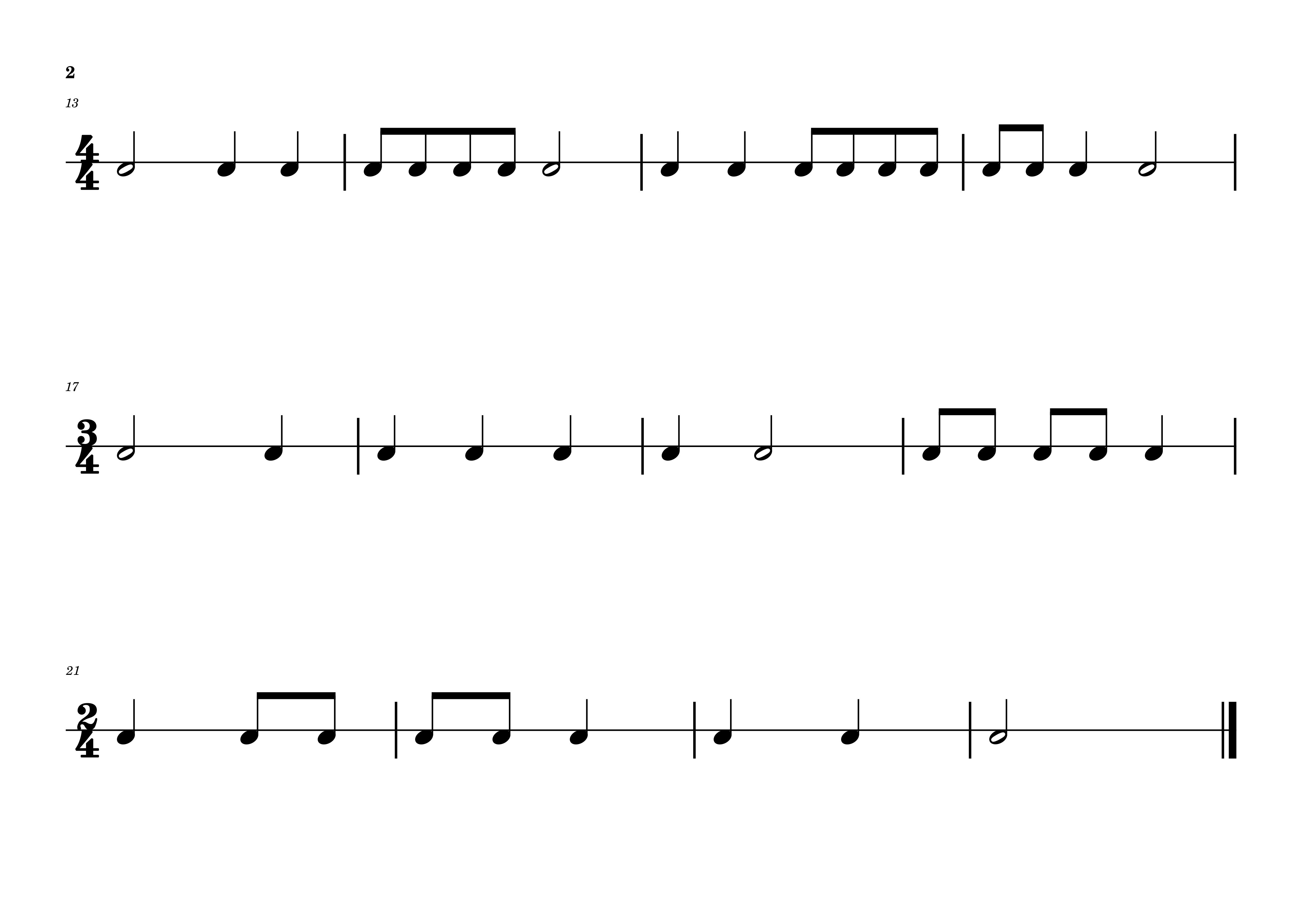
Rhythms to clap

Slide 18
Rhythms to clap

Slide 19
02
Pitch
Grade 1
NOTES IN THE TREBLE CLEF
NOTES IN THE BASS CLEF
NOTES IN BOTH CLEFS (GRAND STAFF)
NOTES WITH STEMS
QUAVERS ON THE STAVES

Slide 20
The Stave/Staff
𝄚𝄚𝄚𝄚𝄚𝄚𝄚𝄚
Notes can be written on all the lines and spaces of the stave.
The higher the note is placed on the stave, the higher its pitch.
A special symbol called a clef is placed at the beginning of each stave.
The pitch of each line and space is determined by the clef.

Slide 21
Notes on the Treble Clef
𝄞
𝄢
Treble Clef / G Clef
Bass Clef / F Clef
The treble or G clef looks like a decorated G.
The clef circles a line that is used to show pitch G.
The bass or F clef looks more or less like an F.
The clef shows a line that is used to show pitch F using two dots on either sides of the line.

Slide 22
Treble Clef and Bass Clef
G clef / Treble clef
𝄞
𝄚𝄚𝄚𝄚𝄚𝄚𝄚𝄚
G line
F clef / Bass clef
𝄢
𝄚𝄚𝄚𝄚𝄚𝄚𝄚
F line

Slide 23
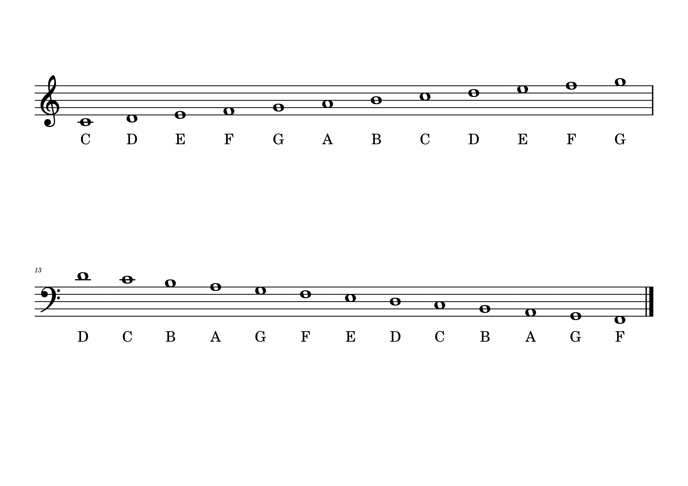

Notes on the Treble Clef
Middle C sits on a ledger-line. Ledger lines are used to extend the stave
Create mnemonics that will help you remember the lines or spaces of the bass clef
FACE - spaces
EVERY GOOD BOY DESERVES FUN - lines

Slide 24
Notes on the Bass Clef
D and C use ledger-lines
Create mnemonics that will help you remember the lines or spaces of the bass clef
ALL COWS EAG GRASS - spaces
GRIZZLY BEARS DON’T FEAR ANYTHING - lines

Slide 25
Parts of a Note
𝅗𝅥 𝅘𝅥 𝅘𝅥𝅮
Flag / Tail
Stem
Note heads
Apart from the semibreve, all other notes have stems
When written on the stave, the stem may face up or down

Slide 26
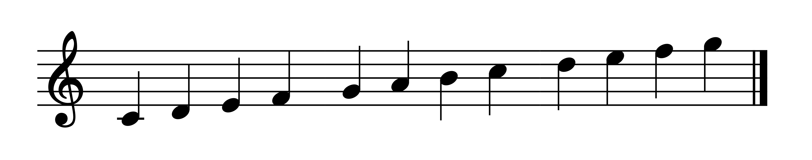
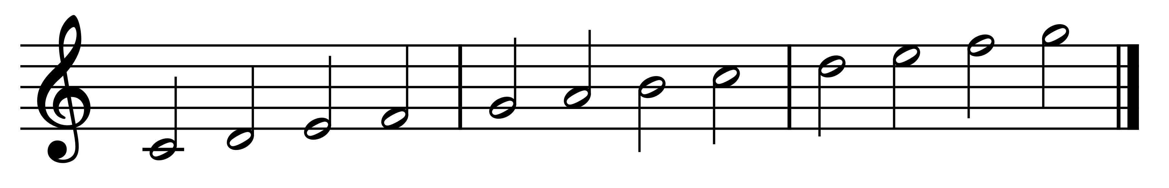
Stem direction
If the note is ON the middle line, the stem can go in either direction.
If the note is below the middle line,
the stem should go up from the right side of the head
If the note is above the middle line,
the stem should go down from the left side of the head

Slide 27
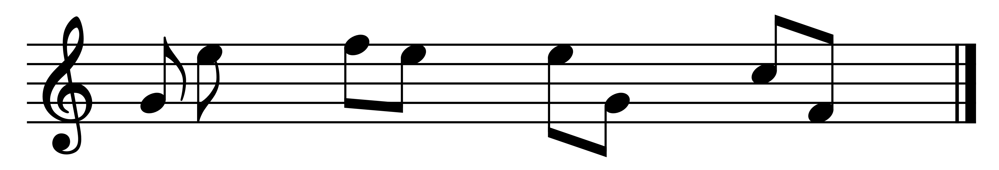
Quavers on the stave
The stem of a quaver follows the same rules as crotchets and minims.
The tails are always attached to the end of the stem and the they are always on the right of the stem, irrespective of the stem direction
When quavers are in pairs their stems always go in the same direction. The note farthest from the middle line determines the direction of the stems.

Slide 28
Thank you, Friends
Quiz: www.chezamusicschool.co.ke/mtg1l1

